Slide 1
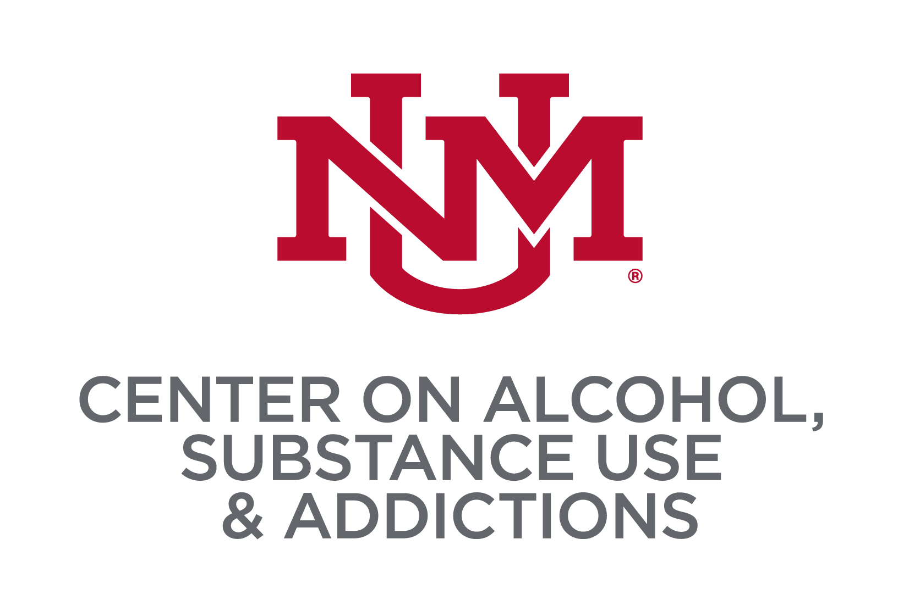
Sleep Disturbances and Stress Uniquely Predict Alcohol Problems among College Students
Vanessa C. Hernandez, Joey C. Mok, Chloe E. Martinez,
Matthew R. Pearson, & Addictions Research Team
Center on Alcohol, Substance use, And Addictions, University of New Mexico
Introduction
Results
Results
Introduction
Results
Sleep disturbances, such as insomnia, are highly prevalent among college students
Perceived stress tends to peak during emerging adulthood and declines during the transition to midlife
Alcohol use (and other substance use) peaks during emerging adulthood (18-25 years old)
Sleep disturbances and perceived stress have been shown to be predictors of alcohol-related problems
Using several indicators of sleep and stress, we sought to examine the unique effects that each have on alcohol-related problems above and beyond the effects of level of alcohol use
Bivariate correlations showed that each sleep-related variable had modest significant associations with AUDIT problems (.133<r’s<.205) and BYAACQ (.129<r’s<.209)
Each stress-related variable had modest significant associations with AUDIT problems (.120<r’s<.198) and BYAACQ (.141<r’s<.211)
We conducted hierarchical regressions such that alcohol use variables were entered in step 1, sleep-related variables were entered in step 2, and perceived stress-related variables were entered in step 3 (see Table below)
We also conducted hierarchical regressions with perceived stress-related variables entered in step 2 and sleep-related variables in step 3 (not shown for ease of presentation)
Alcohol use variables explained 27%-30% of the variance in alcohol-related problems
Sleep-related variables explained an additional 2.9-3.9% of the variance in alcohol-related problems when entered in Step 2 (controlling for alcohol use only), and 1.4% of the variance when entered in Step 3 (controlling for alcohol use and stress)
Across all models, Insomnia Severity Index and Nightmare Distress Scale were uniquely related to both alcohol-related problem measures
Perceived stress-related variables explained an additional 2.3-4% of the variance when entered in Step 2 (controlling for alcohol use only), and .8-1.5% of the variance in alcohol-related problems when entered in Step 3 (controlling for alcohol use and sleep), and
Across all models, Stressful Effects Checklist was the only stress-related variable that uniquely predicted alcohol-related problems
 | AUDIT Problems |  | BYAACQ
 | β | p | β | p
Typical Drinking Quantity | .140 | .003 | .123 | .007
Heavy Drinking Quantity | .048 | .313 | .040 | .380
AUDIT Consumption | .358 | .000 | .404 | .000
 | ΔR²=.270, p<.001 |  | ΔR²=.300, p<.001
Step 2: Sleep
Insomnia Severity Index | .101 | .006 | .101 | .005
Sleep Problem Scale | -.032 | .339 | -.063 | .048
Pittsburgh Sleep Quality Index | -.013 | .704 | -.042 | .205
Sleep Hygiene Index (reverse-coded) | .021 | .423 | .066 | .009
Epworth Sleep Scale | .038 | .108 | .026 | .265
Nightmare Distress Scale | .067 | .010 | .073 | .003
 | ΔR²=.029, p<.001 |  | ΔR²=.039, p<.001
Step 3: Stress
Perceived Stress Questionnaire | -.007 | .820 | .022 | .444
Stressful Events Checklist | .102 | .000 | .125 | .000
Perceived Stress Scale | -.005 | .867 | .018 | .522
 | ΔR²=.008, p=.001 |  | ΔR²=.015, p<.001
Methods
PARTICIPANTS
College students recruited from Psychology Department pools in 9 universities across the United States who participated as part of a larger online survey for course credit (n=5,058)
Measures
Sleep
Insomnia Severity Index (ISI; Bastien et al., 2001)
Sleep Problem Scale (SPS; Jenkins et al., 1988)
Pittsburgh Sleep Quality Index (PSQI; Buysse et al., 1989)
Sleep Hygiene Index (SHI; Mastin et al., 2006)
Epworth Sleepiness Scale (ESS; Johns, 1991)
Nightmare Distress Questionnaire (NDQ; Belicki, 1992)
Stress
College Student’s Stressful Events Checklist -an adaptation of the Social Re-Adjustment Scale (Holmes & Rahe, 1967) & Rahe, 1967);
Perceived Stress Scale (PSS; Cohen et al., 1983)
Perceived Stress Questionnaire (PSQ; Levenstein et al., 1993)
Alcohol Related Outcomes
Daily Drinking Questionnaire (DDQ; Collins et al., 1985)
Brief Young Adult Alcohol Consequences Questionnaire (B-YAACQ; Kahler et al., 2005) to assess alcohol-related problems and severity
10-Item Alcohol Use Disorders Identification Test (AUDIT-US) (Saunders et. al., 1993)
Discussion
Our findings suggest that stress and sleep uniquely contribute to alcohol-related outcomes above and beyond the effects of level of alcohol use
Alcohol interventions may be more effective if they also address stress- and sleep-related factors in this population (e.g., cognitive-behavioral therapy or mindfulness-based interventions)
The cross-sectional nature of the data prohibits causal inference, and we were unable to test possible bidirectional effects among sleep-, stress-, and alcohol-related variables
Longitudinal and experimental studies are needed to determine the relative direct and indirect (i.e., mediated) effects of sleep and stress on alcohol-related outcomes as well as the effects of alcohol use on sleep and stress
CONTACT
e-mail: vhernandez@unm.edu
Website: http://mateolab.yolasite.com/

