Slide 1
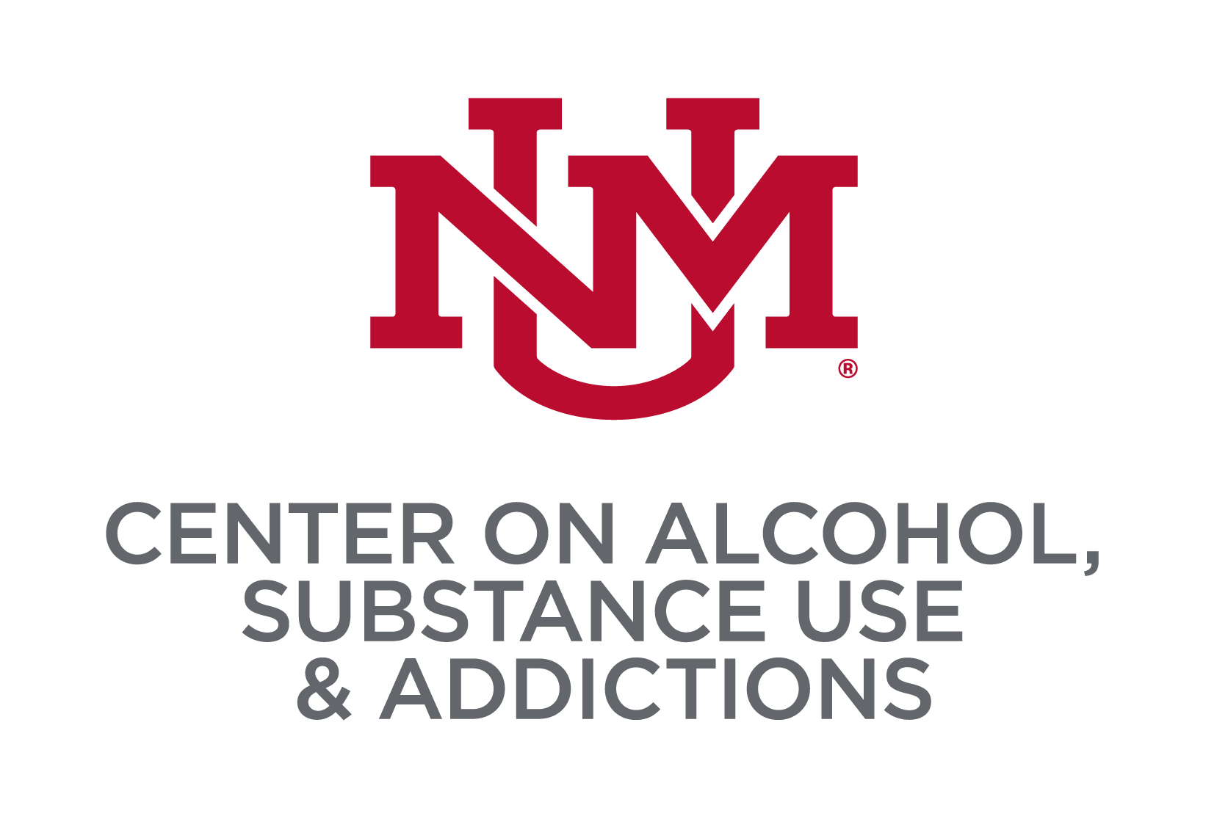
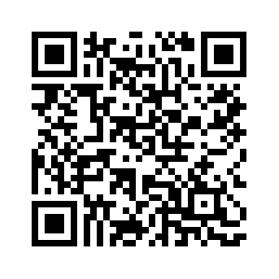
Comparison of In-Person and Online
Alcoholics Anonymous (AA) Engagement
J. Scott Tonigan, Matthew R. Pearson, & Rachel Olsen
Center on Alcohol, Substance use, & Addictions, University of New Mexico
Introduction
Results
Discussion
AA is the most popular resource in the United States for people seeking to reduce problematic alcohol consumption.
There has been a rapid increase in online AA meeting attendance mobilized, in part, by the Covid pandemic.
Little is known about the relative engagement and benefit of attending online versus in-person AA meetings.
This study documented how individuals attending online and in-person AA meetings systematically differed across three domains: (1) demographics, (2) the practice of prescribed AA behaviors, and (3) impressions of AA meeting social dynamics.
Of the 133 EMA participants, 81 attended both in-person and online meetings and 31 reported attending only online meetings (9 reported in-person only meetings and were excluded from further analyses due to the small n).
Overall, the sample was 66% female (n = 74) with a mean age of 43.55 (SD = 11.09). 30% of the respondents were unemployed . Chi square tests indicated gender composition (p = . 25) and employment status (p = .60) were unrelated to type of AA meeting attended. Likewise, ANOVA indicated no mean age difference between the two AA groups (p = .40).
People who attended both types of AA meetings were significantly more likely to report treatment experiences (80.7%) in the 90-day period before recruitment relative to online only participants (51%), X²(1) = 10.59, p < .001. Online only participants were significantly more educated, F(1, 110) = 14.04, p < .02. Last, the two AA groups did not differ on baseline DPDD, but the online only group reported significantly fewer abstinent days at baseline (66.99, SD = 39.43) relative to people who attended both kinds of AA meetings (86.38, SD = 23.61) , F(1, 110) = 10.16, p < .002.
Six logistic regressions were done controlling for baseline values of the dependent measure and days attending formal treatment to examine how the two AA groups differed on six prescribed AA behaviors at 3-months. Two of these were significant: more adults in the mixed group considered themselves AA members (86% versus 52%; B = 1.88, p = .005) and they were more likely to call another AA member for help relative to online only participants (71% versus 42%; B = 1.14, p = .04). Frequency of AA attendance was relatively equal for the two groups, with participants attending AA meetings about half of the available days (51%-52%).
ANOVA’s indicated that at 3-months the two AA groups significantly differed on one of ten GES scales depicting impressions of the social dynamics of AA meetings (Task Orientation; F (1, 95) = 10.77, p < .001). Table 1 displays Hedges g effect sizes for the 10 ANOVA contrasts, with positive effect sizes indicating higher mean values or endorsement of a scale for the in-person AA group. Six of these effect sizes favored the in-person AA group at the small to moderate range in magnitude while the remaining 4 effect sizes were less than .10.
A pressing question facing practitioners is whether to encourage in-person, online, or a mixture of the two AA formats when referring clients to attend AA. Findings indicate that attending both AA formats is associated greater adoption of, and engagement in, AA prescribed practices. Relative to only online AA attendance, people attending both AA formats reported higher rates of considering themselves AA members and they were also significantly more likely to reach out to fellow members for help.
Importantly, it also appears that the fidelity or “message of AA” is stronger in the in-person AA meetings. Participants in the mixed AA format, for example, reported that AA prescribed objectives, tasks, and goals were emphasized/discussed more relative to online only AA meetings. Related, the pattern of effect size estimates for five other impressions of AA meeting social dynamics also were rated higher by participants attending in-person AA. Several of these dimensions, e.g., perceived group cohesion, predict drinking reductions even after controlling for frequency of AA meeting attendance. As such, there may be additional and subtle advantages to attending in-person AA meetings.
Several study limitations should be noted. First, this study was conducted during the COVID pandemic and, as such, access to in-person AA meeting attendance was limited. It is not clear if the additional effort and perceived risk of attending in-person AA meetings led to undetected aspects of self-selection. Second, it is unknown if the observed between-group differences translates into differential drinking outcomes. Replication of findings is strongly encouraged given the rapid increase in accessing online AA meetings.
Acknowledgement
We gratefully appreciate the
funding support by the NIAAA
to conduct the parent study
(R01 AA027508).01 AAR01 AA027508-01 027508-01 01 AA027508-01
Method
PARTICIPANTS AND PROCEDURE
Eligibility criteria were: 1) attended AA in the past 3-months, 2) attended AA no longer than 9-months (lifetime), and 3) an ADS score of > 8.
192 participants were recruited online and virtual interviews were conducted for all participants at baseline, 3, and 6-months. A subset of these participants were assigned to complete ecological momentary assessments (EMA) twice daily (n = 133), and this subset was the sample for present study.
At baseline, mean PDA was 81.01 (SD = 29.97) and mean DPDD was 5.71 (6.96) for EMA participants. Mean AUDIT score for EMA participants was 20.44 (SD = 10.68).
MEASURES
The 10 item CASAA demographic questionnaire was administered to EMA participants at baseline.
The 14 item Twelve Step Participation Questionnaire (Tonigan et al., 1996) collected binary responses (yes/no) on whether EMA participants did any of 8 AA prescribed at 3- and 6-months.
The Group Environment Scale (Moos, 1994) and the Form 90 (Miller & DelBoca, 1996) were used to collect impressions of the social dynamics in AA meetings and treatment experiences and alcohol use, respectively (both administered at baseline, 3, and 6-months).
EMA daily responses were recorded to determine whether, and what type, of AA meeting the 133 participants had attended.

Slide 2
References
Miller, W. R., & Del Boca, F. K. (1994). Measurement of drinking behavior using the Form 90 family of instruments. Journal of Studies on Alcohol, 55(SUPPL. 12), 112–118. https://doi.org/10.15288/jsas.1994.s12.112
Moos, R. H. (1994). Group Environment Scale: Manual.
Tonigan, J. S., Connors, G. J., & Miller, W. R. (1996). Alcoholics anonymous involvement (AAI) scale: Reliability and norms. Psychology of Addictive Behaviors, 10(2), 75–80. https://doi.org/10.1037/0893-164X.10.2.75

