Slide 1
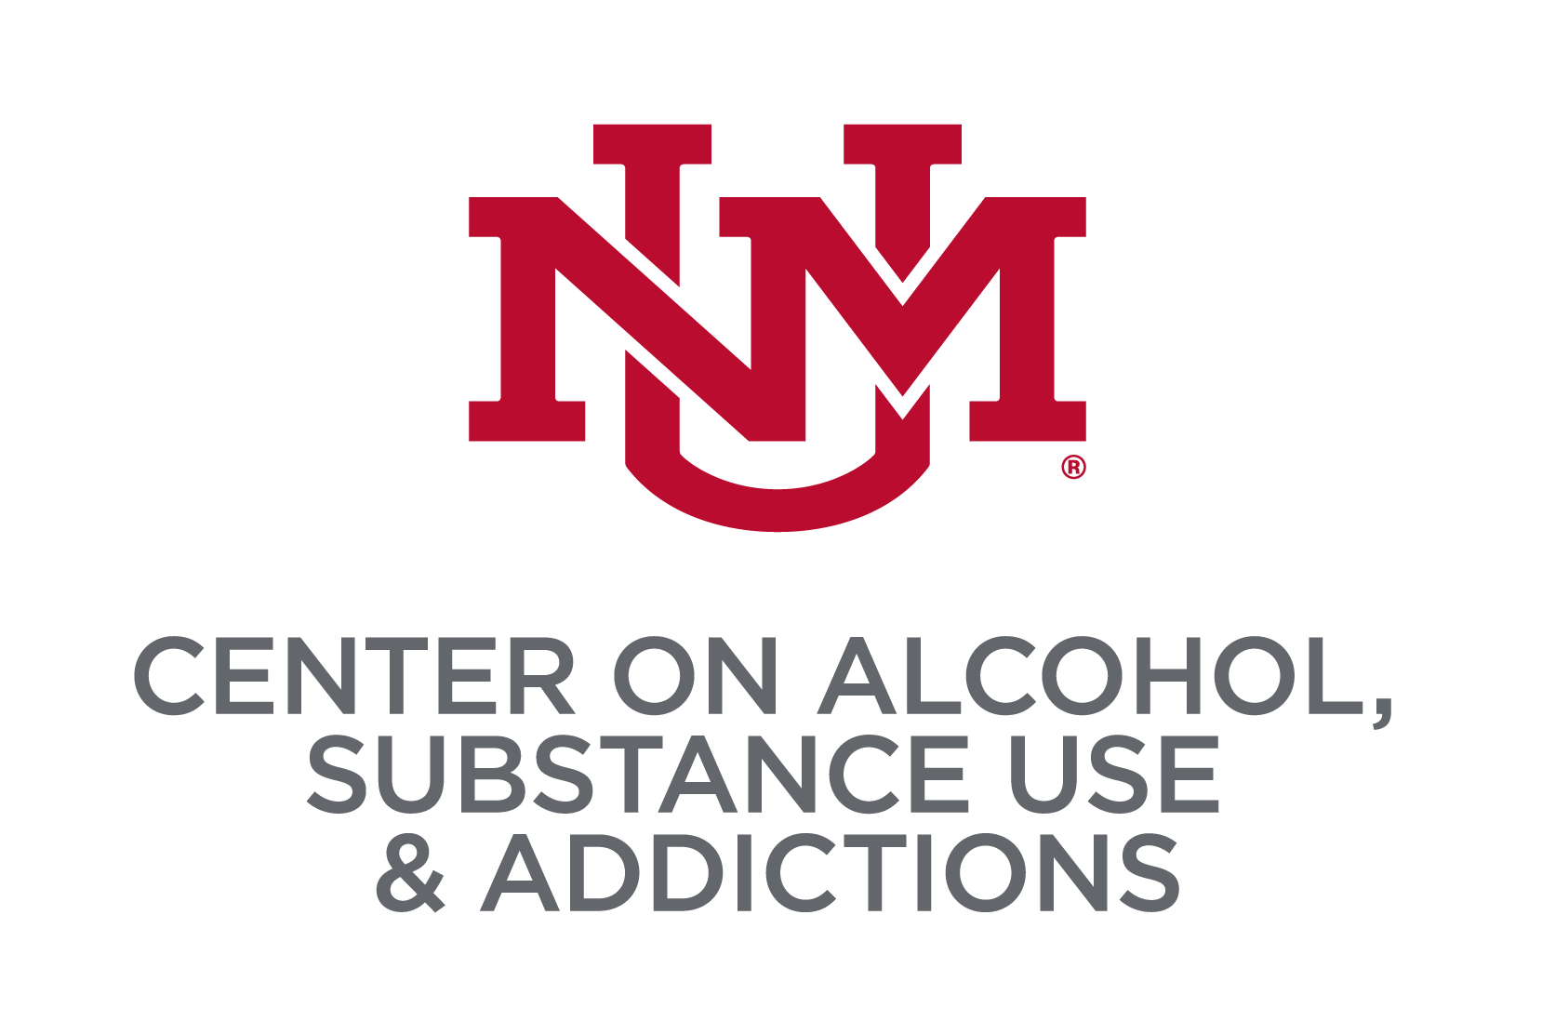
PSYCHOMETRIC PROPERTIES OF THE HARM REDUCTION
SELF-EFFICACY SCALE (HRSES) AMONG COLLEGE STUDENTS
Joey C. Mok, Frank J. Schwebel, Matthew R. Pearson, Addictions Research Team
Center on Alcohol, Substance use, And Addictions, University of New Mexico
Introduction
Results
Results
Introduction
Results
Abstinence self-efficacy has been shown to be a robust predictor of substance-related behavior change (Kadden & Litt, 2011)
Abstinence self-efficacy also neglects the fact that individuals may not be seeking an abstinence-based goal (Collins et al., 2015)
To address this issue, the Harm Reduction Self-Efficacy Scale (HRSES) was evaluated in a sample of individuals recruited from an online substance recovery-oriented support group
Exploratory factor analysis supported a 4-factor solution: 1) Negative Emotions and Situations, 2) Positive Social Situations, 3) Low Self-Regulation, and 4) Pleasant Emotions (Schwebel et al., 2023)
In a larger, college student, sample the present study seeks to use confirmatory factor analysis to further test the psychometric properties of the HRSES
We conducted a confirmatory factor analysis of the 4- factor solution supported by previous research, which fit adequately in our sample (CFI=.911, TLI=.905, RMSEA=.080, SRMR=.042) (See Figure 1 below)
As shown in Table 1, interrelations among HRSES factors ranged between .63-.89
Each HRSES factor was significantly positively correlated with alcohol PBS use (.10<rs<.11) and general PBS (.10<rs<.12)
Only the Negative Situations and Emotions factor was significantly positively correlated with cannabis PBS use (r=.07)
Each HRSES factor was found to be significantly negatively correlated with alcohol use disorder symptoms (-.26<rs<-.18) and cannabis use disorder symptoms (-.16<rs<-.12)
As shown in Figure 1, self-efficacy when experiencing Negative Situations and Emotions was most robustly positively related cannabis PBS use and negatively related to cannabis use disorder symptoms
Low Self-Regulation harm reduction self-efficacy was most robustly negatively related to alcohol use disorder symptoms
We observed one significant suppression effect such Pleasant Emotions self-efficacy had a negative zero-order correlation with alcohol use disorder symptoms, but exhibited a positive association in the SEM model
Table 1. Correlations among HRSES factors, PBS use, and substance use disorder symptoms
 | 1 | 2 | 3 | 4 | 5 | 6 | 7 | 8 | 9
1. Negative Situations and Emotions | ---
2. Positive Social Situations | .63* | ---
3. Low Self-Regulation | .89* | .67* | ---
4. Pleasant Emotions | .86* | .72* | .81* | ---
5. Cannabis PBS Use | .07* | .05 | .04 | .05 | ---
6. Alcohol PBS Use | .11* | .10* | .11* | .11* | .35* | ---
7. General PBS Use | .10* | .12* | .11* | .11* | .31* | .04 | ---
8. Alcohol Use Disorder Symptoms | -.19* | -.26* | -.25* | -.18* | -.03 | -.17* | .21* | ---
9. Cannabis Use Disorder Symptoms | -.16* | -.12* | -.15* | -.12* | -.47* | -.11* | -.18* | .12* | ---
1
.85
Figure 1. CFA Model of HRSES on Substance-Related Outcomes
2
.84
3
.77
Alcohol PBS Use
R² = .051
Method
4
.87
Negative Situations and Emotions
5
.85
PARTICIPANTS
College students from one of ten universities were recruited to participate in the current study
Our analyses were restricted to individuals who endorsed substance use and completed the HRSES measure (N= 2651)
MEASURES
Harm Reduction Self-Efficacy Scale (HRSES). 37-item self-efficacy questionnaire (Schwebel et al., 2023)
Protective Behavioral Strategies Scale (PBSS-21). 21-item alcohol PBS survey (Martens et al., 2005; revised by Treloar et al., 2015)
Protective Behavioral Strategies for Marijuana (PBSM). 17-item marijuana PBS use survey (Pedersen et al., 2016; revised by Pedersen et al., 2017)
Substance Use Protective Strategies Scale (SUPPS). 26-item general (i.e., not substance-specific) PBS survey (Gren et al., 2023)
Alcohol Use Disorder Symptoms (AUDIT) 10-item alcohol consumption, behavior, problem questionnaire (Saunders et al., 1993)
Cannabis Use Disorder Symptoms (CUDIT-R). 8-item cannabis consumption, problem questionnaire (Miller et al., 2016)
11
.87
12
.89
15
.86
.295
14
.90
21
.90
22
.91
-.277
Cannabis PBS Use
R² = .039
24
.87
Discussion
25
.91
30
.90
Overall, model fit was adequate, but not excellent
Further examination of psychometric properties is warranted to refine the scale
We observed some high interrelations about the HRSES factors and one significant suppression effect, warranting examination of alternative factor structures
Next steps include examining measurement invariance across key sociodemographic groups
Given the cross-sectional nature of the data, we are unable to make casual inferences
Additional research is needed to determine the prospective relationship between the HRSES facets and substance-related outcomes over time
31
.88
32
.87
33
.91
.100
34
.89
Positive Social Situations
.097
7
.83
General PBS Use
R² = .008
8
.85
17
.87
18
.87
-.136
27
.80
-.117
35
.88
Low Self-Regulation
36
.86
40
.87
42
.80
-.293
Alcohol Use Disorder Symptoms
R² = .091
43
.90
44
.93
45
.92
47
.85
51
.88
Pleasant Emotions
.141
CONTACT
52
.92
53
.92
Cannabis Use Disorder Symptoms
R² = .061
6
.81
e-mail: thejoeymok@gmail.com
Website: http://mateolab.yolasite.com/
16
.86
26
.89

