Slide 1
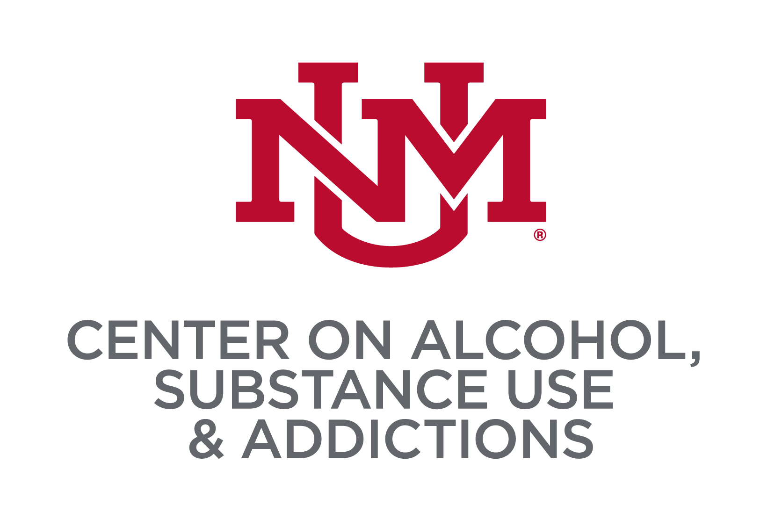
Resilience Factors and Substance Use among Middle School Students from the 2023 New Mexico Youth Risk Resiliency Survey
Vanessa C. Hernandez, Chloe E. Martinez, Joey C. Mok, Ricardo A. Rubio, Matthew R. Pearson
Center on Alcohol, Substance use, And Addictions, University of New Mexico
INTRODUCTION
RESULTS
RESULTS
Substance use remains a significant concern among adolescents as they experience dynamic changes in mental health which can lead to adverse outcomes
Low self-efficacy and low self-esteem each predict higher substance use (Logi Kristjánsson et al., 2010; Richardson et al., 2013).
Individuals with higher Purpose in Life experience more success in treating substance use disorder (Martin et al., 2011) and lower substance use (Abramoski et al., 2018)
Supportive social relationships with adults and peers can be a protective factor against starting and escalating substance use (Gordon et al., 2020; Piko, 2000)
Objective: Examine factor structure of the resilience items from 2023 NM-YRRS, assess measurement invariance between demographic subgroups, and evaluate the concurrent validity of resilience items in predicting substance-related outcomes
ANALYTIC PLAN
Confirmatory factor analysis (CFA) was conducted in Mplus 8.10 (Muthén & Muthén, 1998-2017) to examine 1-, 2-, and 3-factor structures for the resilience items
Multigroup CFA was used to assess for configural, metric, and scalar invariance of the resilience factors across sociodemographic (age, grade, race/ethnicity, language of administration)
Structural equation modeling was used to examine concurrent validity of the resilience factors related to substance-related outcomes
Factor Structure: The CFA model (see Figure) supported a 3-factor structure of resilience items, which included social support (4 items), purpose in life (3 items), and self-esteem/self-efficacy (3 items), X²= 693.8, df=32, p<.0001, CFI=.962, TLI=.947, RMSEA=.037, SRMR=.036
Measurement Invariance Testing: We found support for metric and scalar invariance across every demographic group that we compared including sex, age, grade, language of administration, and racial/ethnic groups
Construct Validity: At the bivariate level, we found social support, purpose in life, and self-esteem/self-efficacy had significant negative correlations with every substance use outcome, ranging from small to moderate (see Table 1)
At the multivariate level, social support consistently uniquely predicted lower substance use; self-efficacy/self-esteem often had the strongest protective effects; purpose in life had some significant positive associations with substance use outcomes (i.e., suppression effect)
Parent
Relationship
R²= .423
Social Support
.650
School
Relationship
R²= .358
.598
.568
Community
Relationship
R²= .323
.558
Peer
Relationship
R²= .312
.763
Future
R²= .640
Purpose In Life
.800
.814
Direction
R²= .662
.664
.734
Engagement
R²= .539
DISCUSSION
METHOD
.918
Coping
R²= .390
Our findings indicate that the 3 resilience factors generally predict lower substance use among middle school students
Although we had strong support for the 3-factor structure, Purpose In Life and Self-Efficacy/Self-esteem were highly correlated
Relatedly, we observed reciprocal suppression effects such that Purpose in Life had positive associations with substance-related outcomes, and Self-Esteem/Self-Efficacy has stronger negative associations (compared to zero-order correlations)
We hope to examine whether our findings replicate in an independent sample (e.g., 2025 NM-YRRS)
Self- Efficacy/ Self-Esteem
.624
PARTICIPANTS
Middle school students (N=17, 815) recruited throughout the state of New Mexico as part of the 2023 New Mexico Youth Risk & Resiliency Survey (NM-YRRS)
MEASURES
Resilience Measures: set of 10 ‘resilience’ items on a 5-point response scale
Substance Use Measures: lifetime DUI passenger exposure, next year intentions to use cigarettes, willingness to use cigarettes, lifetime prevalence of e-cigarette use, lifetime prevalence of alcohol use, lifetime prevalence of cannabis use, lifetime drug count
.834
Confidence
R²= .695
.781
I am Good
R²= .609
Table 1. Associations between Resilience Factors and Substance-Related Outcomes
 | Social Support | Purpose in Life | Self-Esteem/ Self-Efficacy | Social Support | Purpose in Life | Self-Esteem/ Self-Efficacy
Outcome | r | r | r | β | β | β | R²
Lifetime prevalence - DUI-A Passenger | -.169 | -.169 | -.209 | -.164 | .350 | -.477 | .087
Next year intentions – cigarette use | -.231 | -.250 | -.255 | -.112 | .030 | -.184 | .072
Willingness – cigarette use | -.248 | -.287 | -.301 | -.092 | .220 | -.260 | .096
Lifetime prevalence – e-cigarette use | -.202 | -.202 | -.250 | -.191 | .409 | -.557 | .118
Past 30 Day Use - # of forms of tobacco use | -.203 | -.198 | -.206 | -.141 | .081 | -.187 | .052
Lifetime prevalence – alcohol use | -.180 | -.182 | -.233 | -.168 | .410 | -.547 | .101
Lifetime prevalence – cannabis use | -.182 | -.166 | -.215 | -.254 | .553 | -.651 | .139
Lifetime – drug count | -.237 | -.244 | -.280 | -.156 | .237 | -.394 | .094
CONTACT
E-mail: vhernandez@unm.edu
Website: http://mateolab.yolasite.com/

