Slide 1
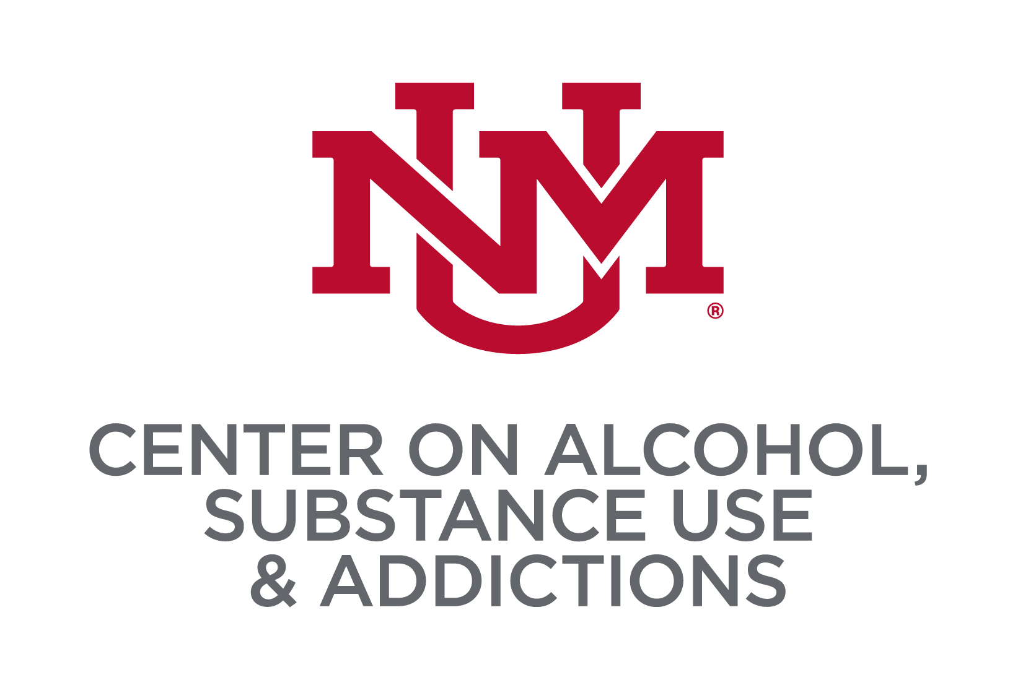
Resiliency and Substance Use Among New Mexican Youth in High School:
Results from the 2021 New Mexico Youth Risk & Resiliency Survey
Kaviya Thiyagarajan, Joey C. Mok, Chloe E. Martinez, Matthew R. Pearson
Center on Alcohol, Substance use, And Addictions, University of New Mexico
INTRODUCTION
5-FACTOR MODEL OF RESILIENCE
Adolescence is a developmental period associated with initiation and experimentation with substance use
It is important to identify protective factors that are associated with lower risk of initiating and escalating substance use during this important developmental period
The 2021 New Mexico Youth Risk & Resiliency Survey (NM-YRRS) included 14 resilience items that are theorized to relate to wellbeing, including lower substance use
To date, the factor structure of these items has not been examined
PURPOSE: In the present study, we used Confirmatory Factor Analysis (CFA) to evaluate factor structure of these resilience items and Structural Equation Modeling (SEM) to examine how these resiliency factors relate to substance use
Home Assets
In my home, there is a parent or some other adult who is interested in my school work
.573
In my home, there is a parent or some other adult who believes that I will be a success.
.763
.549
When I am not at home, one of my parents/guardians knows where I am and who I am with.
School Assets
.784
At my school, there is a teacher or some other adult who listens to me when I have something to say.
.231
.844
At my school, there is a teacher or some other adult who believes that I will be a success.
.414
In my school, there are clear rules about what students can and cannot do
Community Assets
.786
Outside of my home and school, there is an adult who really cares about me.
.839
Outside of my home and school, there is an adult who tells me when I do a good job.
METHOD
Peer Assets
.884
I have a friend about my own age who really cares about me.
PARTICIPANTS
High school students (N=16,253) were recruited throughout the state of New Mexico to participate in the 2021 New Mexico Youth Risk & Resiliency Survey (NM-YRRS)
MEASURES
Resilience Items:
14 resilience items were assessed on a 4-point response scale (1=not true at all, 4=very much true); items were largely derived from the California Healthy Kids Survey (see Figure 1)
We removed 1 item about plans to attend college to improve the scale’s coherence
Substance Use Outcomes:
These items assessed lifetime prevalence of cigarette use, past 30-day use of e-cigarettes or vaping, past 30-day use of alcohol, past 30-day marijuana use
We computed the number of forms of tobacco used in the past 30 days (e.g., cigarettes, e-cigarettes, spit tobacco, cigars, and hookah)
We computed the number of drugs used in one's lifetime and in the past 30 days (e.g., synthetic marijuana, prescription pain medications without prescription, cocaine, heroine, methamphetamines, ecstasy, and inhalants)
ANALYSIS PLAN
Using Mplus 8.10 (Muthén & Muthén, 1998-2017), we conducted confirmatory factor analyses to test competing factor structures for the resilience items and used fit statistics and factor interpretability to select the optimal factor structure
To test the concurrent validity of the resilience factors, we examined the zero-order bivariate correlations of these factors with a wide range of substance-related outcomes as well as the multivariate unique associations of these factors with substance-related outcomes
.830
I have a friend about my own age who helps me when I’m having a hard time.
Constructive Use of Time
.666
At school I am involved in sports, clubs, or other extra-curricular activities (such as band, cheerleading, or student council).
.629
Outside of my home and school, I am involved in music, art, literature, sports, or a hobby.
.786
Outside of my home and school, I am a part of clubs, sports teams, church/temple, or other group activities.
RESULTS
DISCUSSION
We found that a 5-factor model showed the best fit with our sample, CFI=.979, RMSEA=.024, SRMR=.026, including Home Assets, School Assets, Community Assets, Peer Assets, and Constructive Use of Time (see Figure above)
Home Assets were consistently related to lower substance use and was the strongest predictor for each outcome (see Table 1)
Constructive Use of Time was weakly related to less substance use
Peer Assets and Community Assets were weakly positively associated with substance use
School Assets were not significantly related to substance use outcomes
Although our resilience factors significantly accounted for each substance-related outcome, the amount of variance explained was modest (5.4-9.5%)
Consistent with some previous research, Peer Assets were related to more substance use
This finding might be because our items did not account for factors like prosocial peers, amount of peer support, type of peer support, etc.
Given that the present study was a secondary data analysis, additional work is needed to confirm the factor structure of the resilience items and determine whether the observed relationships replicate across unique samples
Table 1. Multivariate associations between resilience factors and substance use outcomes
 | Home Assets | School Assets | Community Assets | Peer Assets | Const use of Time
Substance Use Outcomes | β | β | β | β | β | R²
Lifetime Prevalence – Cigarette Use | -.343 | .035 | .062 | .118 | -.127 | .091
Past 30 Day # of Forms of Tobacco | -.398 | .037 | .121 | .116 | -.049 | .080
Past 30 Day Use – Vaping | -.320 | .005 | .127 | .141 | -.090 | .062
Past 30 Day Use – Alcohol | -.325 | -.001 | .091 | .093 | .009 | .054
Past 30 Day Use – Marijuana | -.290 | .044 | .068 | .081 | -.116 | .064
Past 30 Day Use – Drugs | -.418 | .041 | .088 | .073 | -.012 | .095
Lifetime Prevalence – Drug Use | -.383 | .033 | .060 | .100 | -.048 | .091
CONTACT
Email: kthiyagarajan@unm.edu
Website: https://mateolab.yolasite.com/

